Slide 1


Gary Grief, Executive Director, Texas Lottery
SMART-TECH 2016
NEW YORK CITY
WHAT NOW?
The $1.5 Billion Question

Slide 2
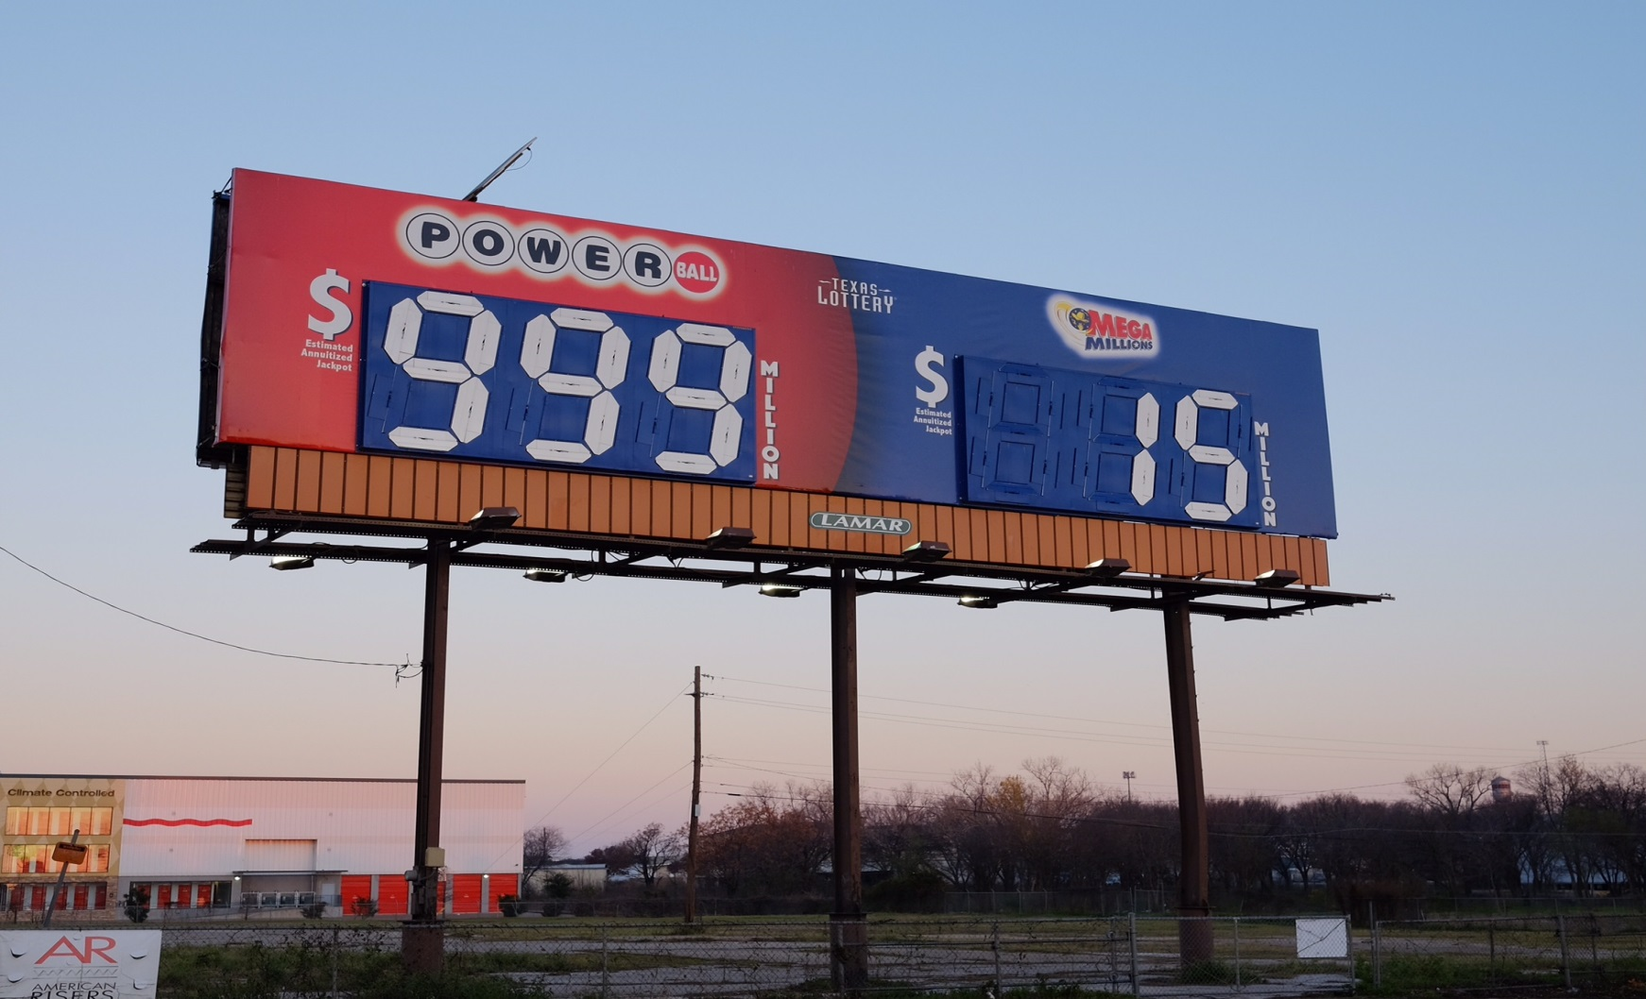
SMART-TECH 2016
NEW YORK CITY

Slide 3
Gary Grief, Executive Director, Texas Lottery
SMART-TECH 2016
NEW YORK CITY
WHAT NOW?
The $1.5 Billion Question

Slide 4
POWERBALL JACKPOT FATIGUE = SALES DECLINE
SMART-TECH 2016
NEW YORK CITY
AVG JP NATIONWIDE SALES
__________________________________
2012 $85 M $3.96 BILLION
2013 $120 M $5.95 BILLION
2014 $117 M $4.82 BILLION
2015 $105 M $3.99 BILLION

Slide 5
OVERDUE FOR CHANGE
SMART-TECH 2016
NEW YORK CITY
POPULATION JACKPOT ODDS
__________________________________
2009 129,000,000 1 IN 195 MILLION
2015 307,000,000 1 IN 175 MILLION

Slide 6
SMART-TECH 2016
NEW YORK CITY
POWERBALL GAME CHANGES
OCTOBER 2015
MATRIX CHANGE
JACKPOT ODDS INCREASED FROM 1:175M TO 1:292M
OVERALL ODDS DECREASED FROM 1:31.8 TO 1:24.9
INCREASED 3RD PRIZE FROM $10K TO $50K
CHANCE FOR PLAYERS TO MULTIPLY MOST PRIZES BY UP TO 10 TIMES WHEN THE JACKPOT IS $150 MILLION OR LESS

Slide 7
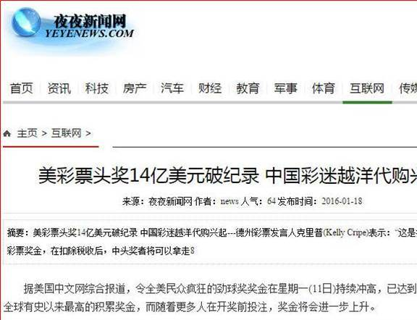
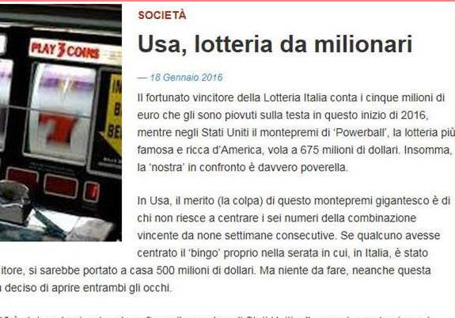
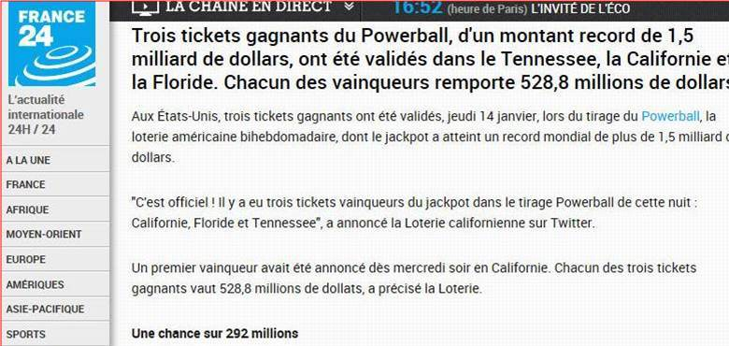
SMART-TECH 2016
NEW YORK CITY
FRANCE
ITALY
CHINA
COLUMBIA
KOREA
CANADA
JAPAN
AUSTRALIA

Slide 8
VIDEO
SMART-TECH 2016
NEW YORK CITY

Slide 9
IMPACT OF RECORD JACKPOT
SMART-TECH 2016
NEW YORK CITY
SALES AND REVENUE
RETAILER ECONOMICS
MILLENIAL PENETRATION
SOCIAL MEDIA EXPANSION
LOTTERY AND VENDOR CORE COMPETENCIES

Slide 10
KEY FINDINGS FROM LEGER SURVEY FEBRUARY 11-18, 2016
SMART-TECH 2016
NEW YORK CITY
88% AWARENESS OF JACKPOT
$500 MILLION JACKPOT WAS THE “SPOT”
TEN MILLION NEW POWERBALL PLAYERS
HALF OF ALL AMERICANS BOUGHT A TICKET

Slide 11
SMART-TECH 2016
NEW YORK CITY
WHAT NOW?
The $1.5 Billion Question
LEVERAGE INROADS MADE WITH MILLENIALS AND SOCIAL MEDIA
OVERCOME FUTURE JACKPOT FATIGUE
MANAGE EXPECTATIONS WITH POLICYMAKERS
LEVERAGE THE REVENUE RECORDS IN EVERY STATE
MAINTAIN FOCUS ON RETAILER EXPANSION AND PRODUCT INNOVATION

Slide 12
THANK YOU!
SMART-TECH 2016
NEW YORK CITY

